Slide 1

Annual On-Street Parking Permit (AOSPP)
Sub- Python Programming SPRING
2024 -23128
By- Sravya. Vemireddy
Pavan Ganesh Reddy. Yeruva
Afrida Mehanaz. Shaik
Kushwanth Reddy. Nomula

Slide 2
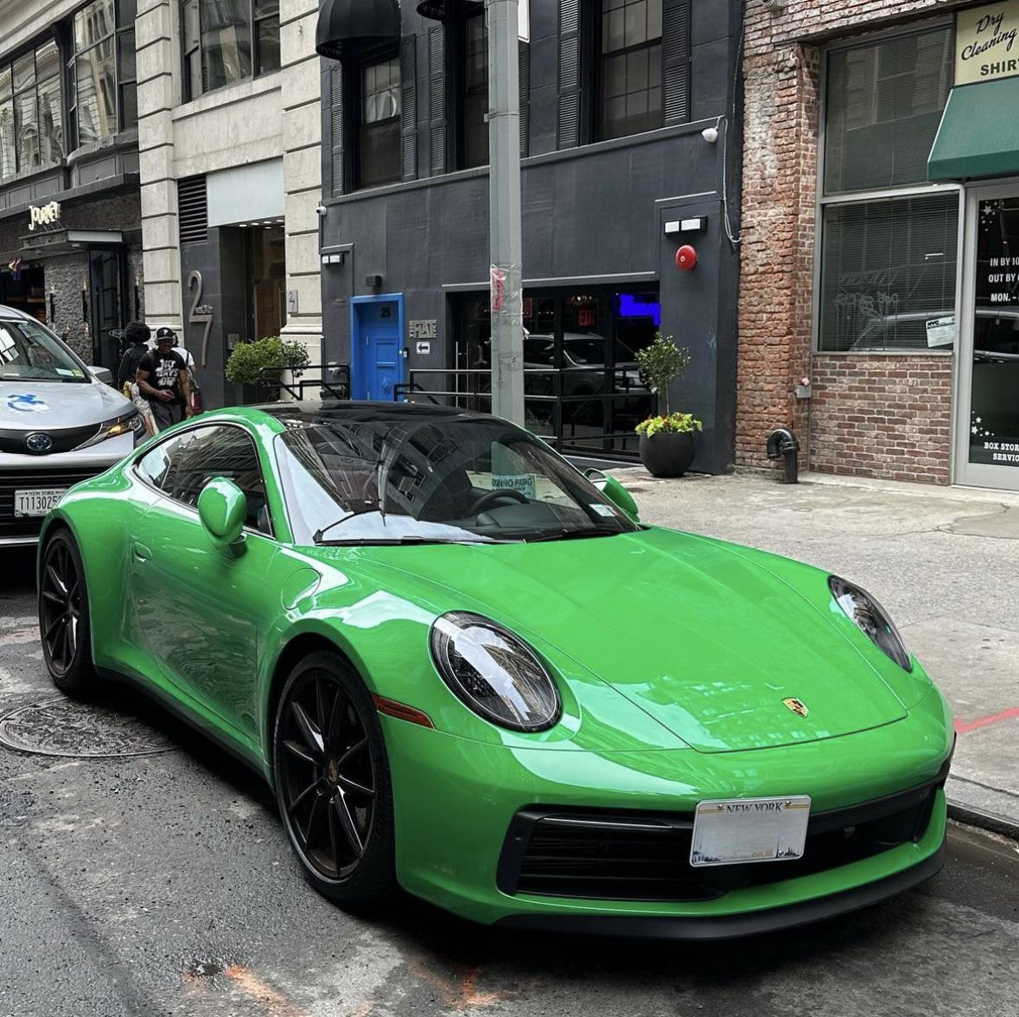
ABOUT THE PROJECT:
Annual On-Street Parking Permits (AOSPP) are issued to not-for-profit organizations.
The permit allows vehicles limited standing and parking privileges in loading zones and at parking meters while carrying out the organization's mission.

Slide 3

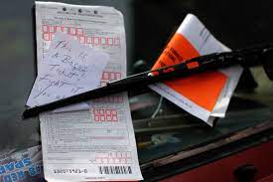
MOTIVATION FOR THE PROJECT:
MY PARKING TICKETS

Slide 4
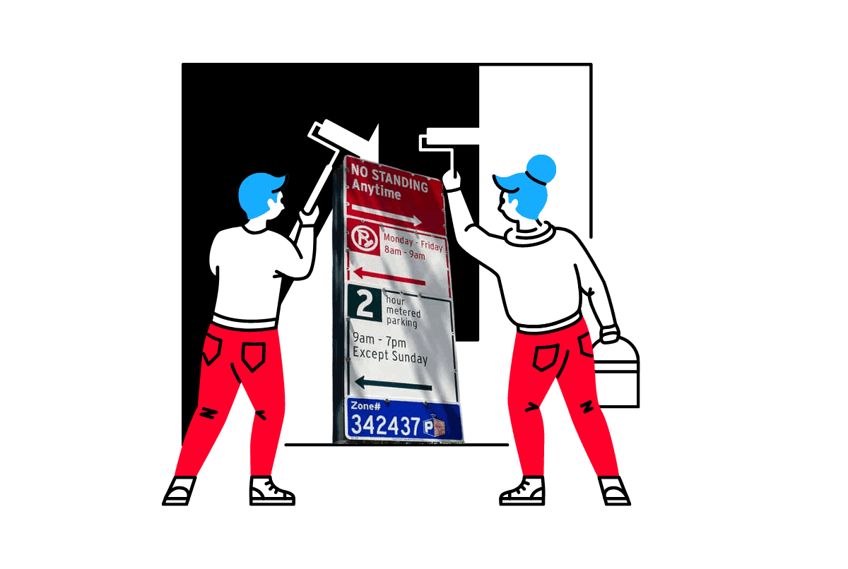
DATASET DETAILS:
DATASET PLATFORM- Department of Transportation (DOT)
Facilitate Operations: AOSPPs provide parking privileges in loading zones and at meters, streamlining activities like deliveries and event setup for organizations.
Enhance Outreach: These permits enable easier access to parking, aiding organizations in attending meetings, conducting outreach programs, and delivering services to communities.
Boost Efficiency: By reducing time spent searching for parking, AOSPPs allow organizations to focus resources on their core missions, enhancing operational efficiency.
Promote Accessibility: AOSPPs make services more accessible to the public by ensuring convenient parking, facilitating community participation in healthcare, education, and social programs.

Slide 5
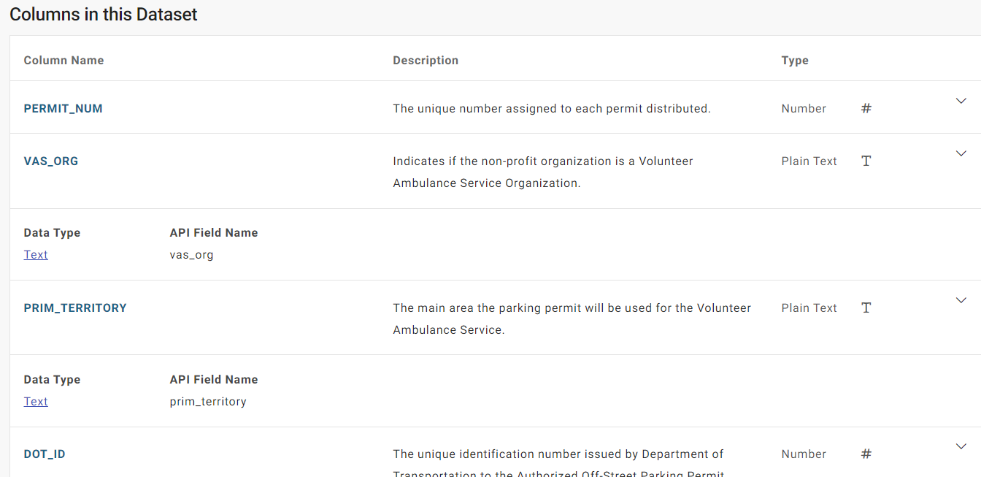
ATTRIBUTES INCLUDED:

Slide 6
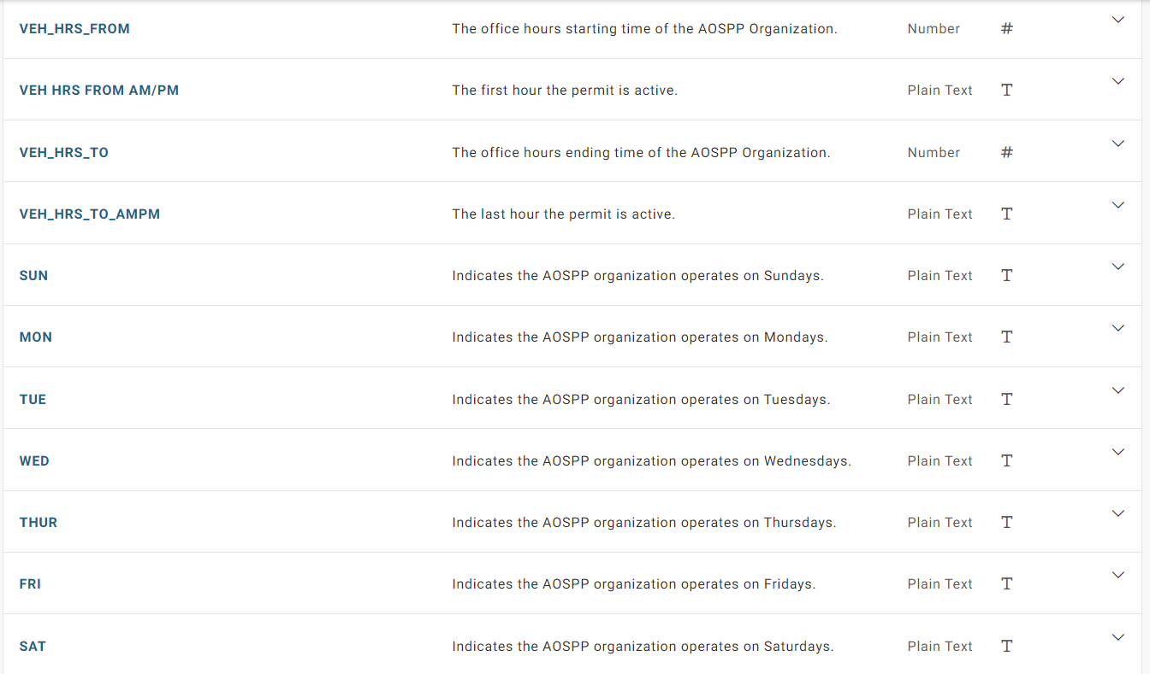

Slide 7
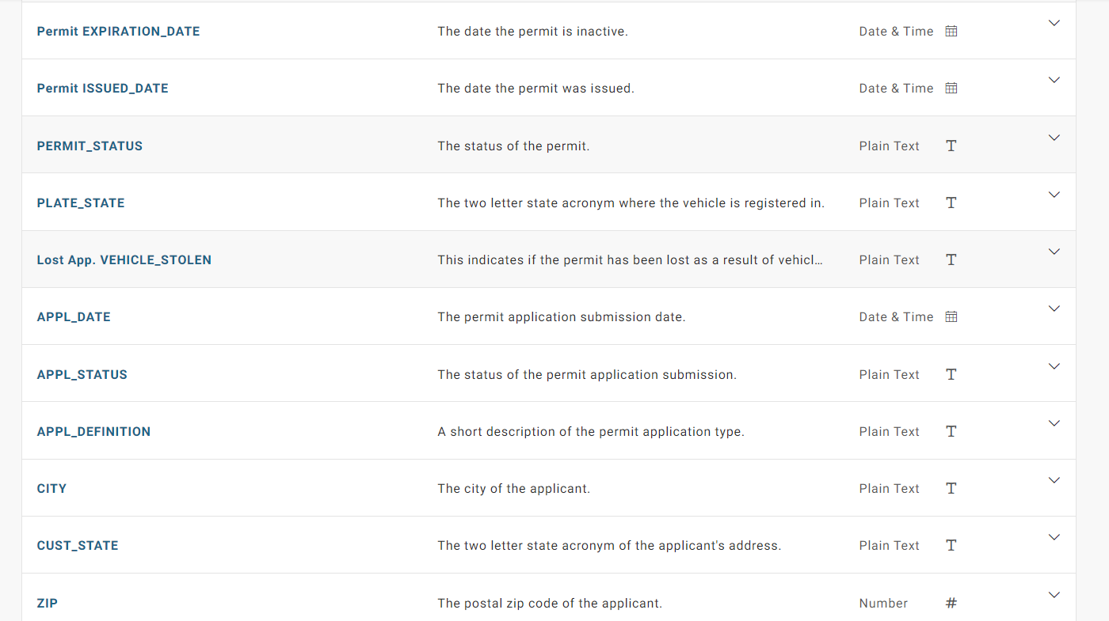

Slide 8
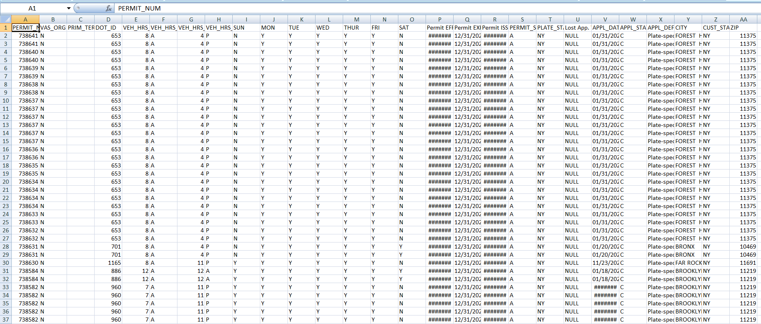

Slide 9
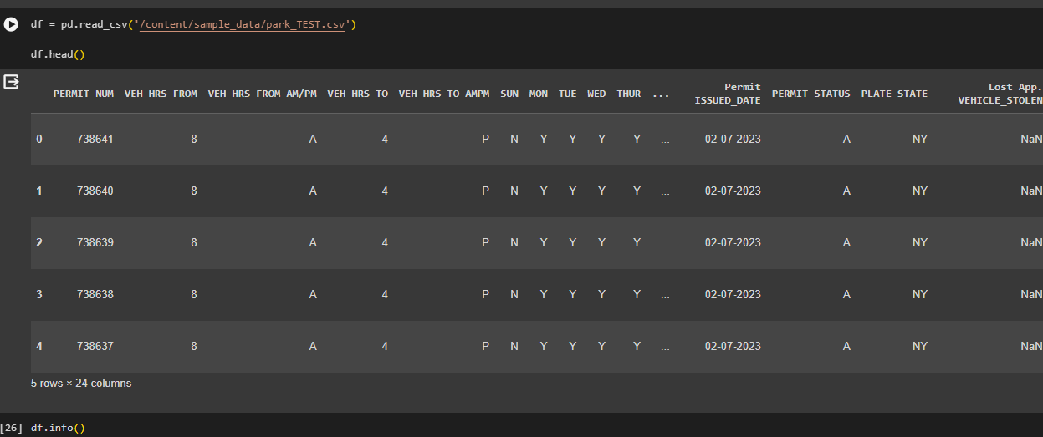
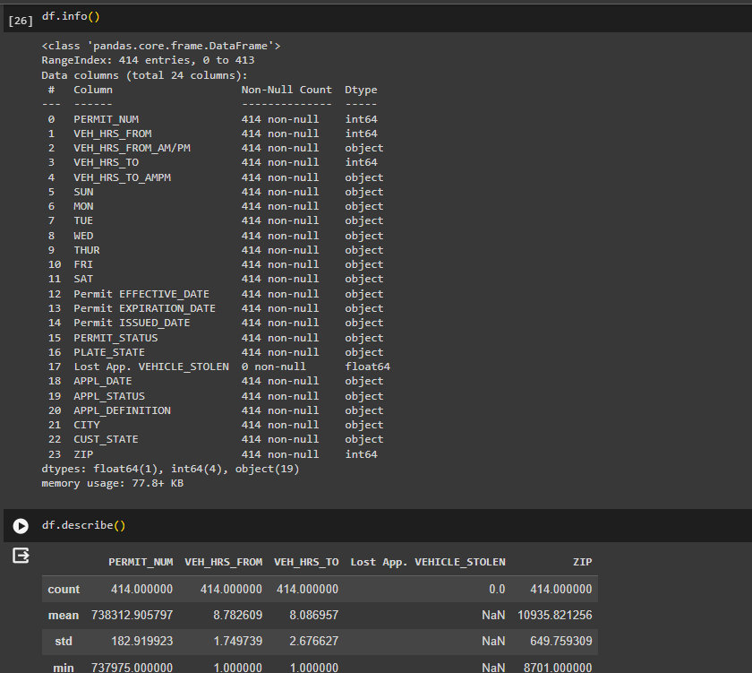
Data Exploration and Cleaning :

Slide 10
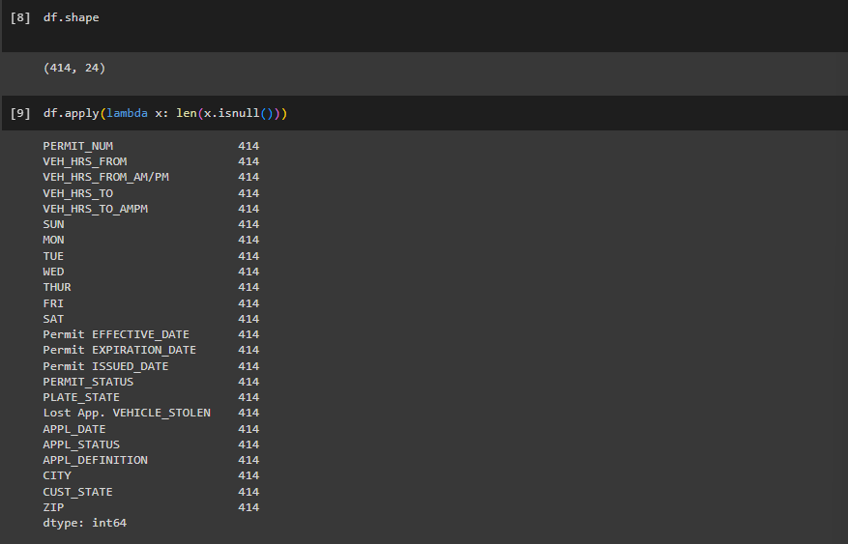
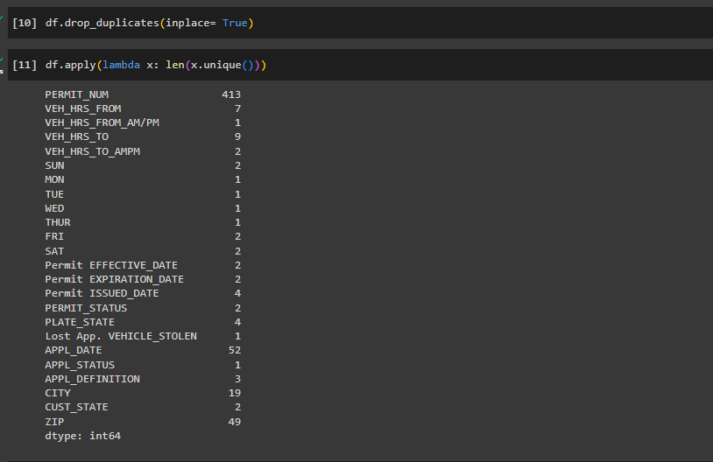
Data Exploration and Cleaning :

Slide 11
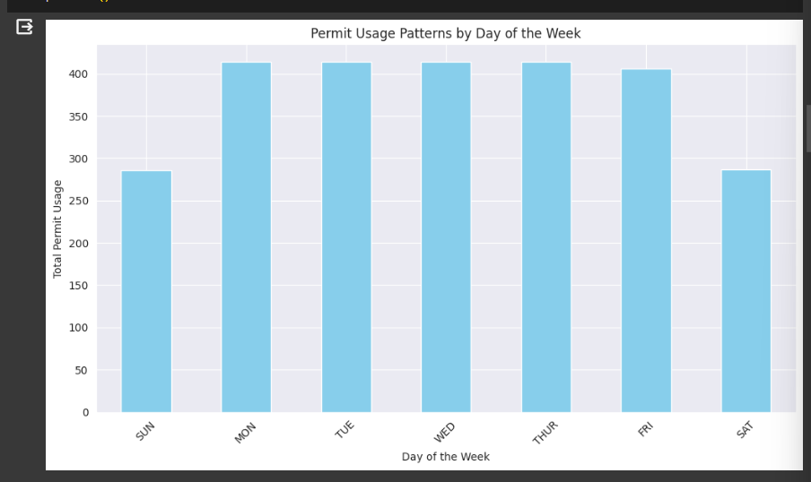
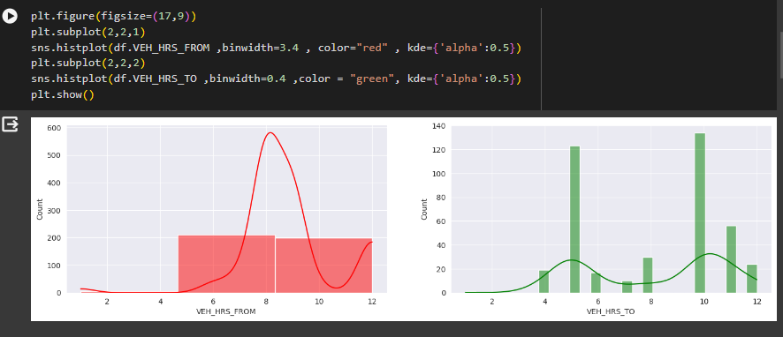
Data Analysis AND Visualization:

Slide 12
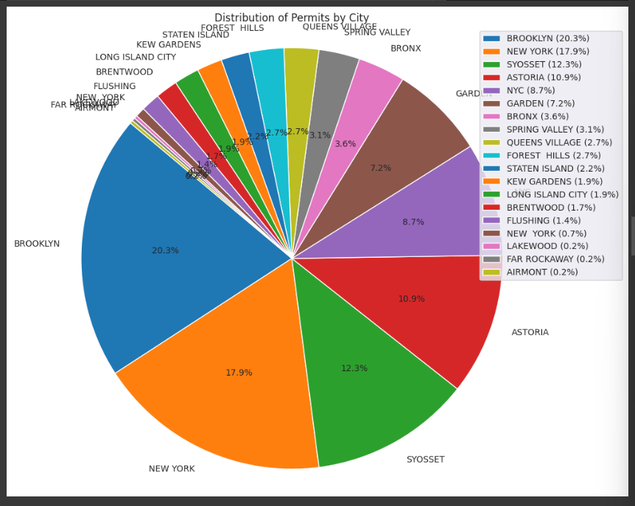
Data Analysis AND Visualization:

Slide 13
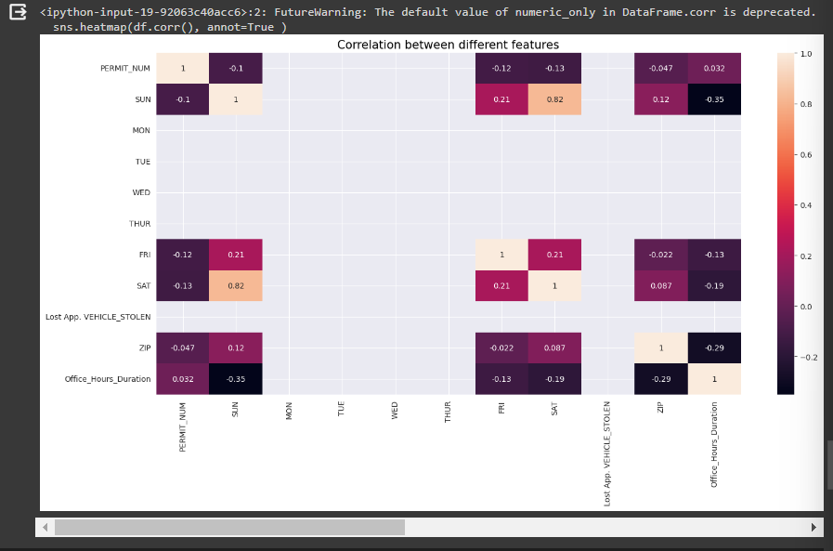
Data Analysis AND Visualization:

Slide 14
Project Objectives:
Here, After analyzing all the data from the data set We can use the model to calculate the number of hours a car can park in a provided region with a zip code and also we can see how many hours a car can park in ,
-> In a region
-> In a day
-> In a whole week.
Each customer is provided with a particular permit number which allows him to access the parking entries with certain hours and here using this model we can get all the details a person can be provided with the Aospp and he can be accurate with all the timings by being aware about the areas included.

Slide 15
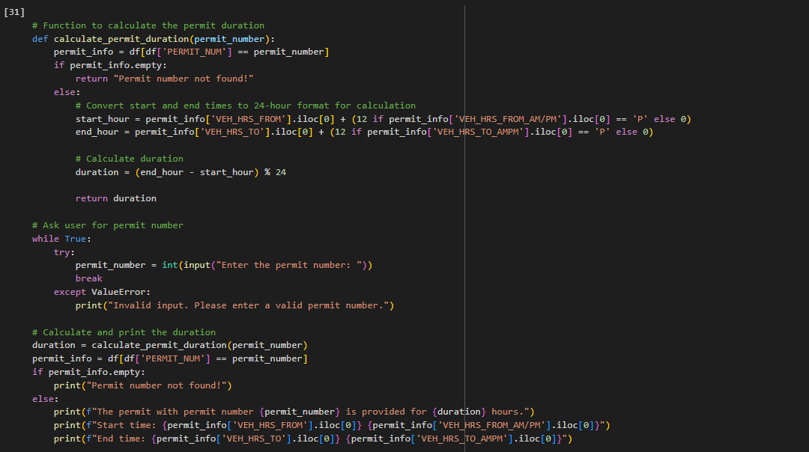
Project Objectives:

Slide 16

Project Objectives:
And the answer provided in this format

Slide 17
Project Objectives:
In addition to the objective above , we also created a code which expects a permit number from the user and analyzing this number from the data set it will provide some key details of the user’s permit with all the zip code and the permit time given.
Each customer is provided with a particular permit number which allows him to access the parking entries with certain hours and here using this model we can get all the details a person can be provided with the Aospp and he can be accurate with all the timings by being aware about the areas included.

Slide 18
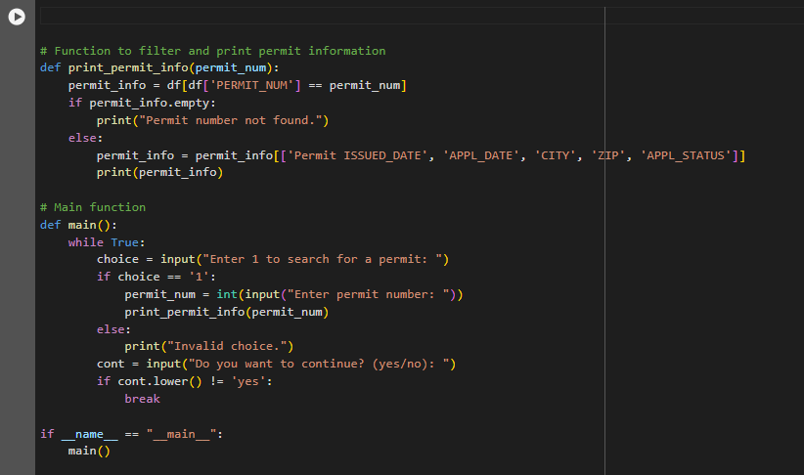
Project Objectives:

Slide 19
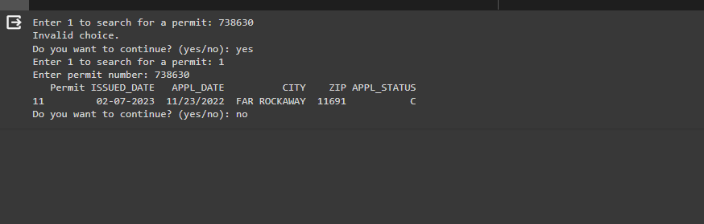
Project Objectives:
And the answer provided in this format

Slide 20
PROJECT OUTCOMES:
Thus , a code has been written by providing the parking permit number and now we are able to draw the details of the parking lot regarding the timings area and the specification required and we can see the Count of hours that has been granted for the user.
Now this can be considered as an objective of the project and also it can be extended further with some applicable ideas like predicting the timings that Can be provided with the given zip code. And also we can predict the probabilities of getting a slot of parking in each day of a week.

Slide 21
REFERENCES :
https://pandas.pydata.org/docs/reference/api/pandas.DataFrame.iloc.html
https://data.cityofnewyork.us/Transportation/Annual-On-Street-Parking-Permit-AOSPP-/ue2f-z6i6/about_data
https://data.ny.gov/browse/select_dataset?tags=parking
https://www.contracostalafco.org/policies/agricultural-open-space-preservation/
https://www.facebook.com/NYCDOT/posts/please-note-2020-city-parking-permits-for-people-with-disabilities-pppd-temporar/10158136683362887/
https://nycanalytics.gitbook.io/2018-nyc-opendata-examverf-report/results/department-of-transportation-dot

Slide 22
Challenges and Solutions:
Collaboration Issues in the Team:
Action:
Clearly define positions and duties: Handle disagreements in a positive way:
Resource Constraints:
Limited availability of resources, such as time, or personnel, can hinder project progress and limit the ability to achieve project objectives effectively.
Action :
Prioritize critical tasks
Optimize resource allocation:
Explore alternative resources:

Slide 23

Challenges and Solutions:
Unusual dataset issues :
Editing the dataset created some issues with compiling errors and reading data
Action : Deleted certain attributes that created redundencies and compacting the dataset entries had created a solution.

Slide 24
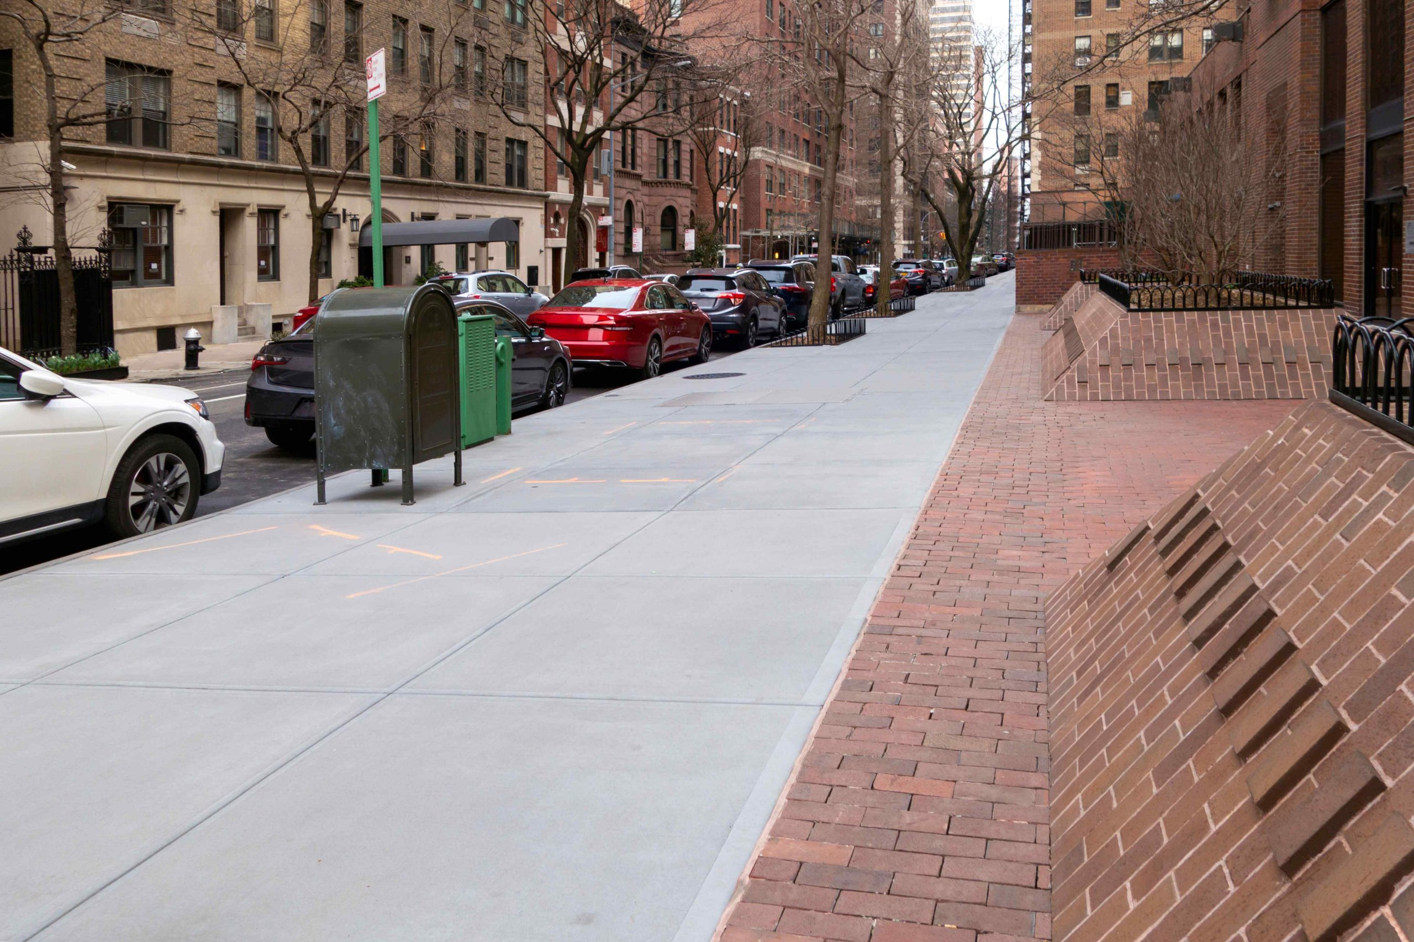
THANK YOU
By-
Sravya. Vemireddy
Pavan Ganesh Reddy. Yeruva
Afrida Mehanaz. Shaik
Kushwanth Reddy. Nomula

